Slide 1
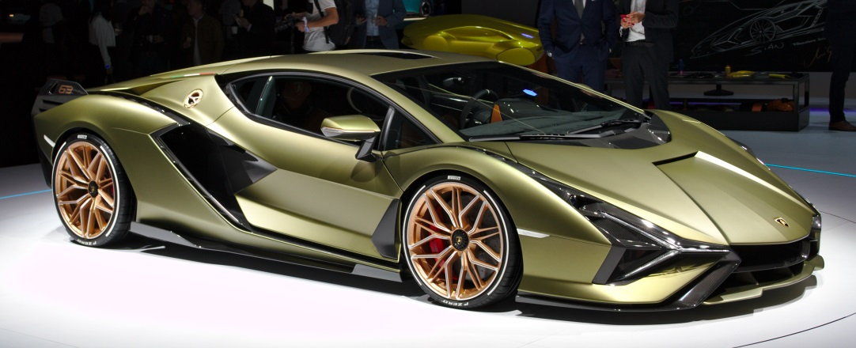
Lariat Car Rental
Presented By – Jonathan Simon

Slide 2
Introduction
Overall, Lariat Car Rental’s performance in 2018 is promising. Net revenue exceeded $19M.
Lariat has 50 individual branches and a fleet of 3,556 unique vehicles.
Lariat is very competitive in both the Airport and Non-Airport rental car market.
Lariat seeks to increase net revenue and become even more competitive in the overall market.
What strategies can Lariat Car Rental employ to increase net revenue?

Slide 3
2018 Baseline Metrics
Overall performance is promising, but how can we increase net income?
2018 baseline 37.4% profit margin

Slide 4
2018 Baseline Metrics
Overall branch performance shows that each branch is profitable.

Slide 5
Most profitable branch locations

Slide 6
2018 Baseline Metrics
Are Airport or Non-Airport branches more profitable?
Key distinction in rental car market.

Slide 7
2018 Baseline Metrics
Lariat’s fleet generates significant net income per vehicle.

Slide 8
Strategies to increase net revenue
Strategy 1 – Increase Non-Airport Branches by 10 and assume average vehicle count per branch remains the same.
Strategy 2 – Increase average vehicle count to 90 per branch.
Key Assumption – Demand will increase with an increase in company locations and supply.
Combine strategies to create substantial increase in net revenue.

Slide 9
Strategy 1 – Increase Non-Airport Branches
Based upon the average increase in net profitability for Non-Airport branches vs. Airport branches, Lariat should focus its expansion of Non-Airport locations.
Average cars per location remains the same, as we obviously cannot open new locations with no rental cars in stock.
Proposed increase from 50 locations to 60 locations, with all 10 new locations in non-airport locations.
Average cars per location remains at 71, with a total fleet of 4,267.

Slide 10
Strategy 1 – Increase Non-Airport Branches by 10.
Increases overall net income by approximately $4M
Assumes that Lariat can find locations with sufficient demand.

Slide 11
Strategy 2 – Increase average vehicle count to 90 per branch
Only variable changed from 2018 baseline is an increase in average vehicles per branch from 71 to 90.
Increases total vehicle fleet to 4,500.
Assumes that average cost and net profit per vehicle remains the same.
Assumes that demand exists for addition of 19 vehicle per location and that Lariat will not cannibalize its own market.

Slide 12
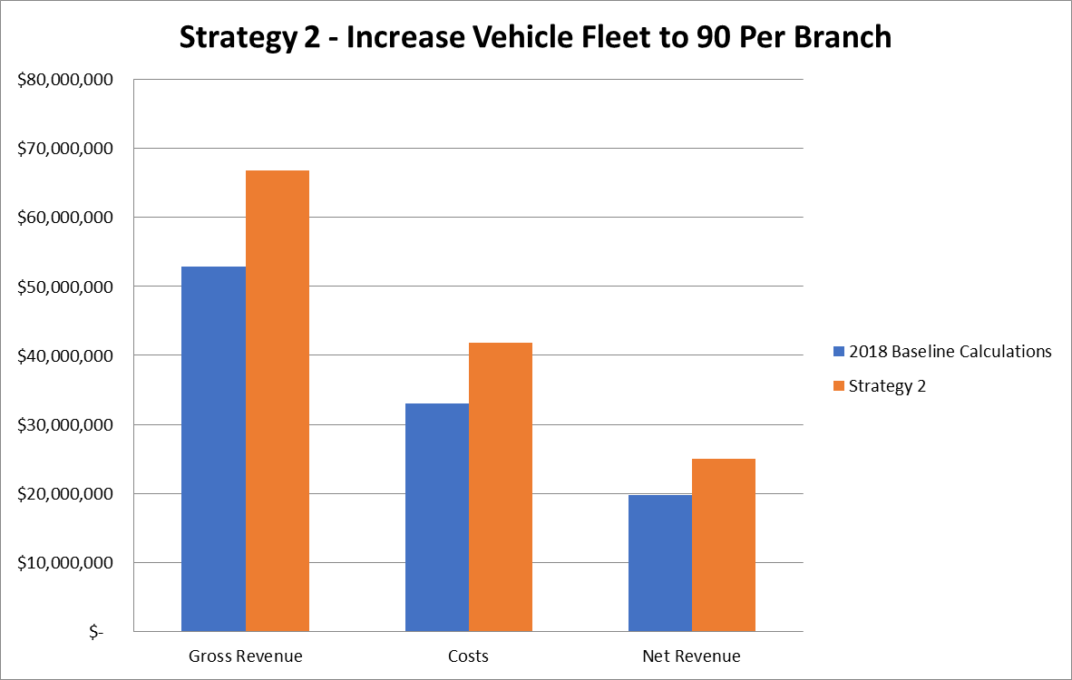
Strategy 2 – Increase Average Vehicle Count to 90 per branch
Net Revenue increases by approximately $5.2M

Slide 13
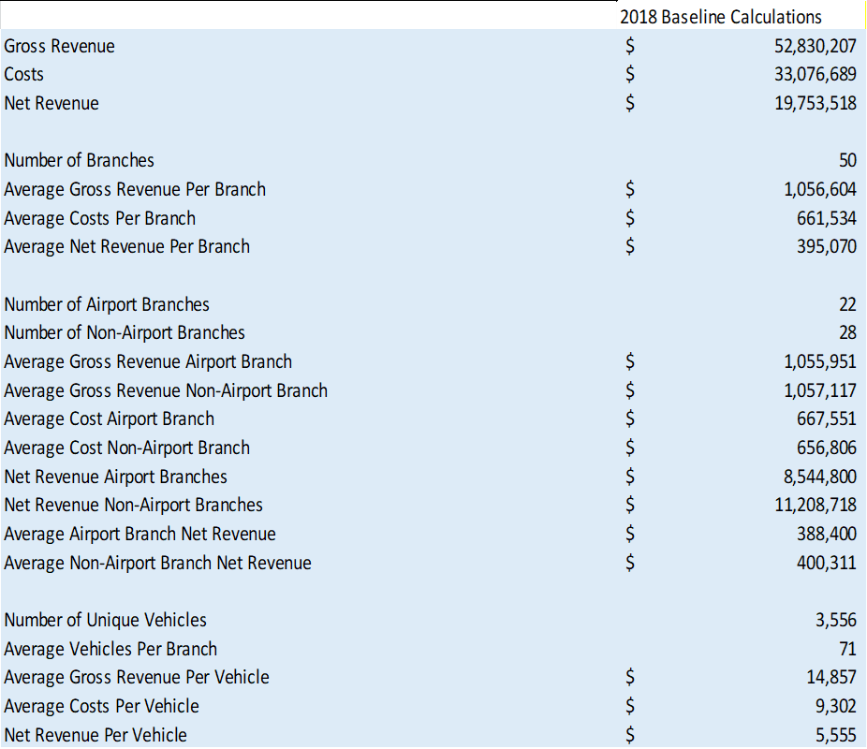
Combine Strategy 1 and Strategy 2

Slide 14
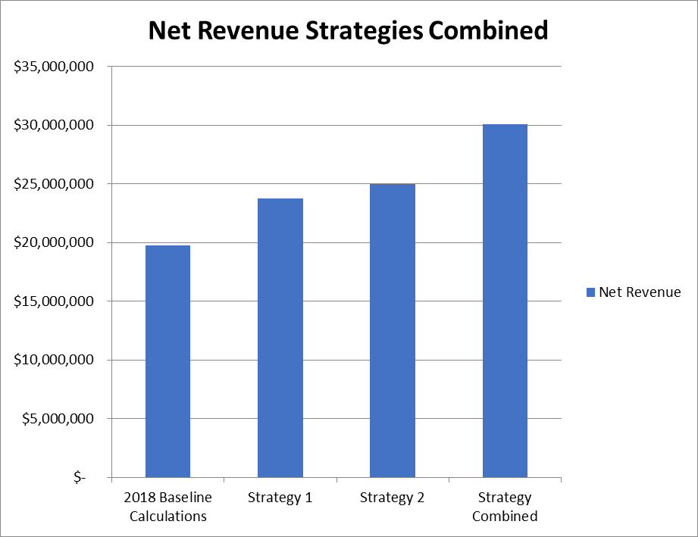
Combine Strategy 1 and Strategy 2
Creates an additional $10.3M in net revenue.
52% increase in net revenue for year 2019.

Slide 15
Recommended Actions
Increase Non-Airport Branches from 28 to 38.
Increase average vehicle count from 71 to 90.
Maintain net income per branch and per vehicle.
Keeps costs the same for year 2019.
Increase net revenue by $10.3M!

Slide 16
Thank you for attending!

